Slide 1

Building Your College and University Mail Center’s Brand
Presented by Pat Ring and Betsy Shortell

Slide 2


Slide 3
In this session we will focus on tips and ways to:
  Add value to your operation
  Increase worth/impression of your group
  Build your mail center’s brand

Slide 4
“How do we make ‘them’ know that we are worth more?”
Notes:
Introduction through this presentation we’re hoping to give you some hints and tales from our experience on how to grow your operations and show value to your campus or University

Slide 5
“It’s Complicated…”
Notes:
Introduction through this presentation we’re hoping to give you some hints and tales from our experience on how to grow your operations and show value to your campus or University

Slide 6
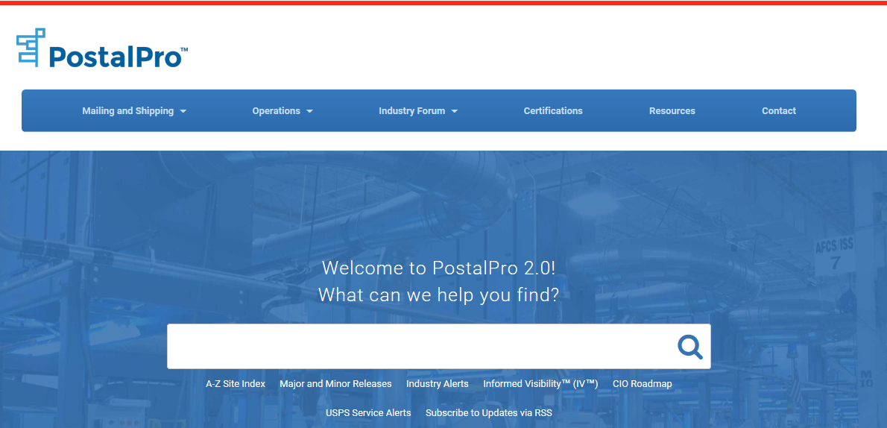
Be Experts!
  Stay on top of changes in the industry
  Make sure you (and your staff)know what you’re talking about
  Look it up! Research!
    USPS.com
    Postal Explorer (pe.usps.gov)
    PostalPro
    DMM
    Notice 123
  Education
Notes:
Not just the bosses! Make sure you get your staff trained so that they can answer questions without a manager getting involved. Perry Mason

Slide 7



Join Groups
MSMA
PCC
NACUMS
Regional C&U Associations
Take advantage of what membership offers!
Notes:
Discounts for members, some are free to join. Free webinars and educational sessions. Help with certifications. Contact either Pat or Betsy for help in joining local chapters

Slide 8
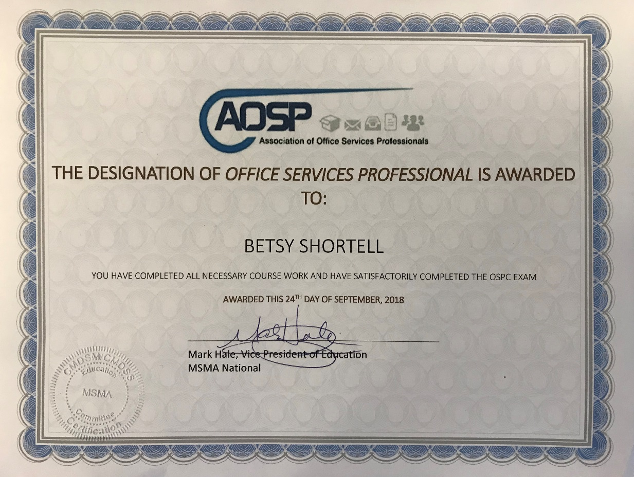
The Power of Certifications
    Proof of Expertise
    Credentials that make you stand out
    Can be added to job descriptions
    Resume builders
      Certifications travel
Notes:
Every organization is different, but certifications are easy to get (MDP through USPS, open book cost is $75 low hanging fruit)

Slide 9
Know Your Business
  Who are your customers?
  What areas do you and your staff need expertise in?
    International Mail?
    Hazardous Materials?
    All Shipping Options- - -FEDEX-UPS-DHL ?
    Other distribution areas and opportunities on your campus?
  What adds value—even if it’s not a revenue source?
  Know your business before someone else does (or thinks they do!)

Slide 10
Evaluate Resources and Workload
      Employee Schedules
      Pick-ups From Post Office
      Volume Measurements
        Mail Make-up Has Changed
      Sort Schemes
        Still Valid?
      Employee Skills

Slide 11
Analyze Mail Flows
  Things have changed at the Postal Service
    Service standards have changed
    Processing locations have changed
    When you receive your mail may have changed
  Has this impacted the service You provide?

Slide 12
Find Weaknesses
  Lack of training
  Lack of cross-training
  People in wrong place at wrong time
  Double handling/redundancies
  Customer satisfaction
Weakness=Opportunity

Slide 13
“We’ve Always Done It That Way”
Notes:
Harvard story of when I first started…heard this from my staff and I asked “why?” That’s how we’ve always done it

Slide 14

“We just do Mail…”
Notes:
Harvard story of when I first started…heard this from my staff and I asked “why?” That’s how we’ve always done it

Slide 15
Empower Staff
    Make sure they are in!
    Do They Understand Mail’s Whys & Wherefores?
    Do They Understand your operations Whys & Wherefores?
    Ask them for input and suggestions.
    “Let Me Tell You What I Did!”
Notes:
I gave my drivers business cards so that when they were on the front line and got questions about service they could refer them to the office/mgrs

Slide 16
Chase Complaints
  Listen To What They Are Saying
    Customers and Employees
  Fanatical Follow-up
  Attack your critics!
    Give Them Options & Solutions
    Turn Them Into Believers
Complaints=Opportunities

Slide 17
Employee Appearance
Is your staff…
  Neat and presentable?
  In uniform?
  Polite, positive and helpful?
  Professionals offering professional service?
“Ladies and Gentlemen Serving Ladies and Gentlemen”**
** Ritz Carlton

Slide 18
Track KPI’s
What are your KPI’s
(Key Performance Indicators)?
  Know the difference between SLA’s and KPI’s
    SLA: Measures the service delivery (i.e. how many deliveries per day, time of delivery)
    KPI: Measures the overall achievement of goals over time (i.e. overall delivery accuracy of 99%, generating cost reductions of greater than $100,000 annually )
  Report these up!
  Customer Service scores usually #1 indicator of performance
    Surveys!
Notes:
How do our customers feel we are doing? What are your Key Performance Indicators? Define KPI circle back on critics Great presentation at MailCom by Mark Loveridge from CBRE

Slide 19
Outsource the Outsourcers !
Benchmarking
  Measuring your operation against peers and the industry
    Mail volume
    Productivity
    Rates/fees
    Salaries
Knowing how you stack up compared to competition
Are you charging appropriately?
Can you do the work more cheaply than an outside company?
Notes:
The NACUMS website has a great benchmarking tool for measuring mail volume. Can also assist in processing information (how many pieces processed/hour). Harvard outsourced a moving company because we knew that they were charging more than double our courier rate. We went to this department armed with information to sell our service at a lower cost.

Slide 20
Partner With The People Who Matter
      Procurement
      Student organizations
      Finance
      Facilities
      The President/Dean
      Peers
Notes:
HUMS not on procurement website as preferred vendor…we didn’t have this connection.

Slide 21

Keeping Costs Down
  Eliminate duplication
  Manage the workload
    Volumes vs. hours
    Curtail non-preferential mail
    OT – Is it really needed?
    Eliminate Saturdays
    Offer options
  Delivery fleet management
    Foot vs. vehicle transport
    Vehicle types
http://www.recruiteze.com/wp-content/uploads/2017/01/bigstock-Costs-Money-Finance-Investment-119295518-300x246.jpg
Notes:
Offer options: customers cant afford on call courier, or multiple day delivery schedule where and when you can offer options.

Slide 22

Add Value
What Can You Offer?
  Knowledge!!!!!!!
    Educational seminars
    In office training
  Direct outreach
    Get out and visit!
      Is service Ok?
      What do they need?
  More with less…
  The value of keeping work “in-house”
https://www.cbs.dk/files/cbs.dk/styles/cbs_content/public/value_price_0.jpg?itok=auN7y3LN
Notes:
Keeping in house, confidentiality more with less: training staff to do different jobs, increase expectations but also qualifications making them more valuable.

Slide 23
Make Your Mail Center The “Go To”
It’s ok if you can’t do it all! But, make your center the first place they think of!
  First right of refusal
  Expert knowledge of who can do the job
    Customers remember good service, even if it is a referral
  Track the work you turn down
    Might turn into a future business opportunity!

Slide 24
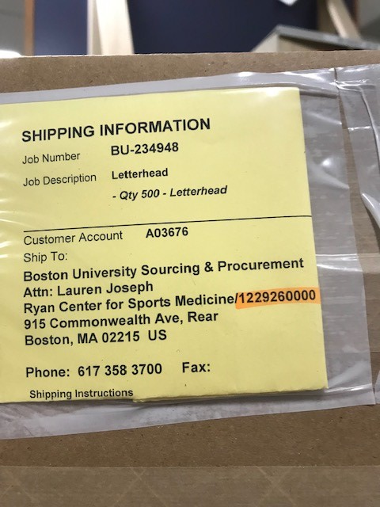
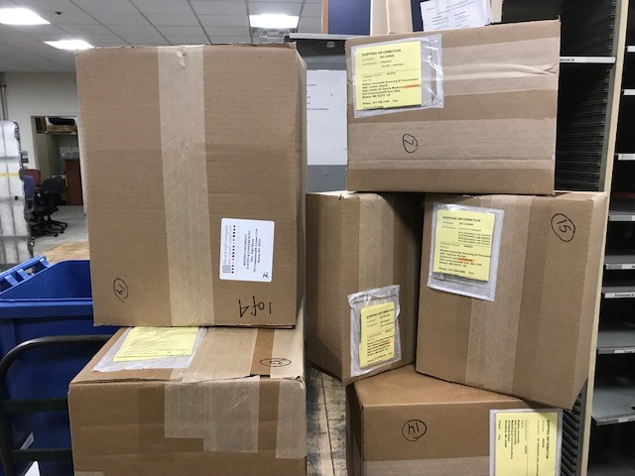
Seize Every Opportunity For New Business

Slide 25
Leverage Technology and Resources
    Get maximum value from your vendors
      Are you getting what you are paying for?
      Use your vendors as resources!
      Mail Center design
      Help with product selection
        Multiple uses?
Notes:
PB IMpB, make sure you’re getting what you pay for
HR department help to rewrite job descriptions/benchmarking salaries

Slide 26
Leverage Technology and Resources
Bring in your experts (on campus resources)
  Campus IT
  Procurement
  HR
Notes:
PB IMpB, make sure you’re getting what you pay for
HR department help to rewrite job descriptions/benchmarking salaries

Slide 27
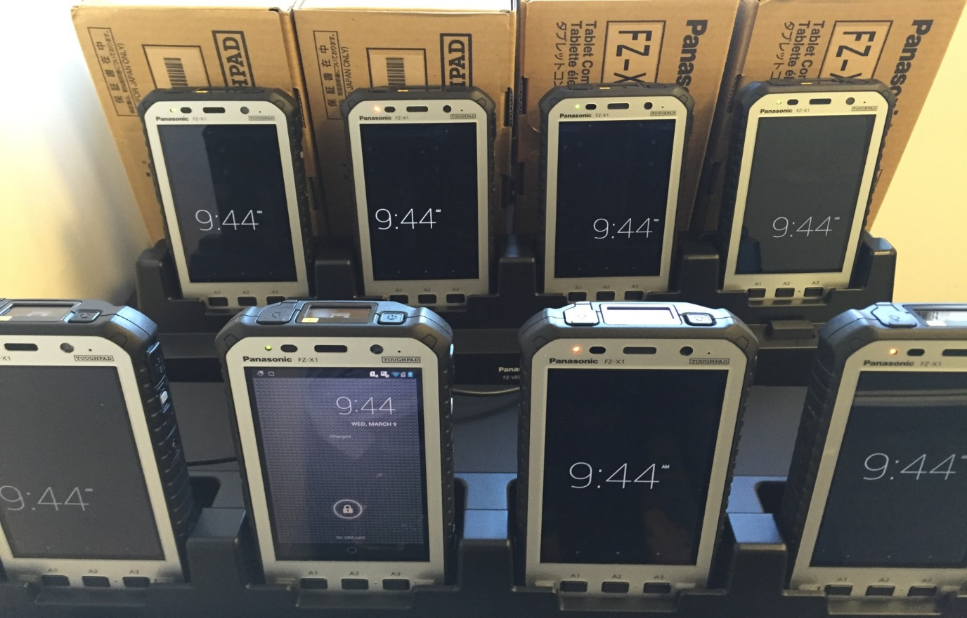
New Technology

Slide 28
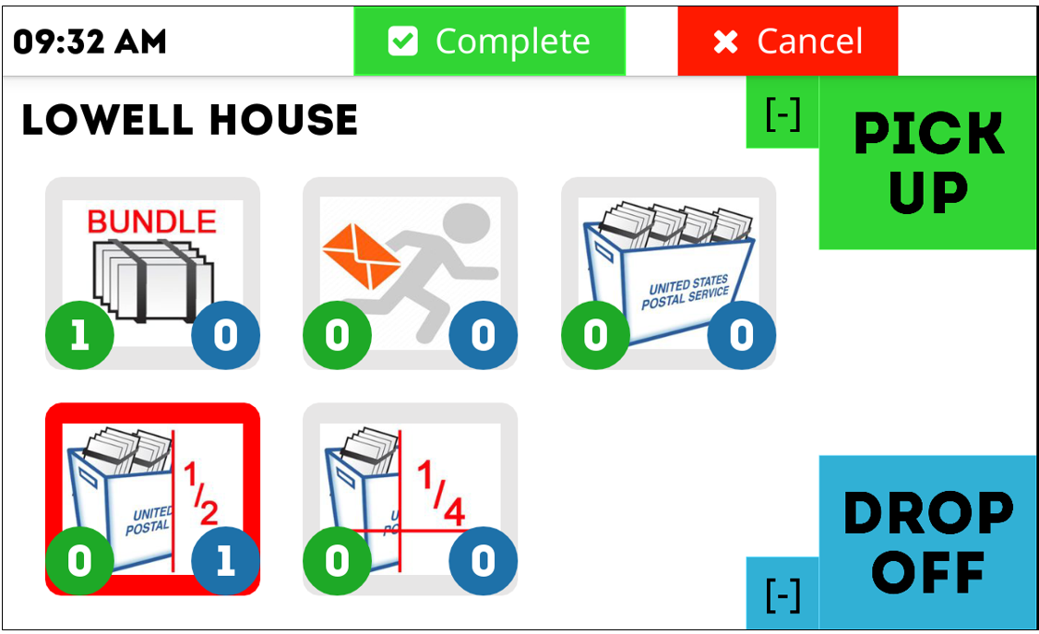

Slide 29
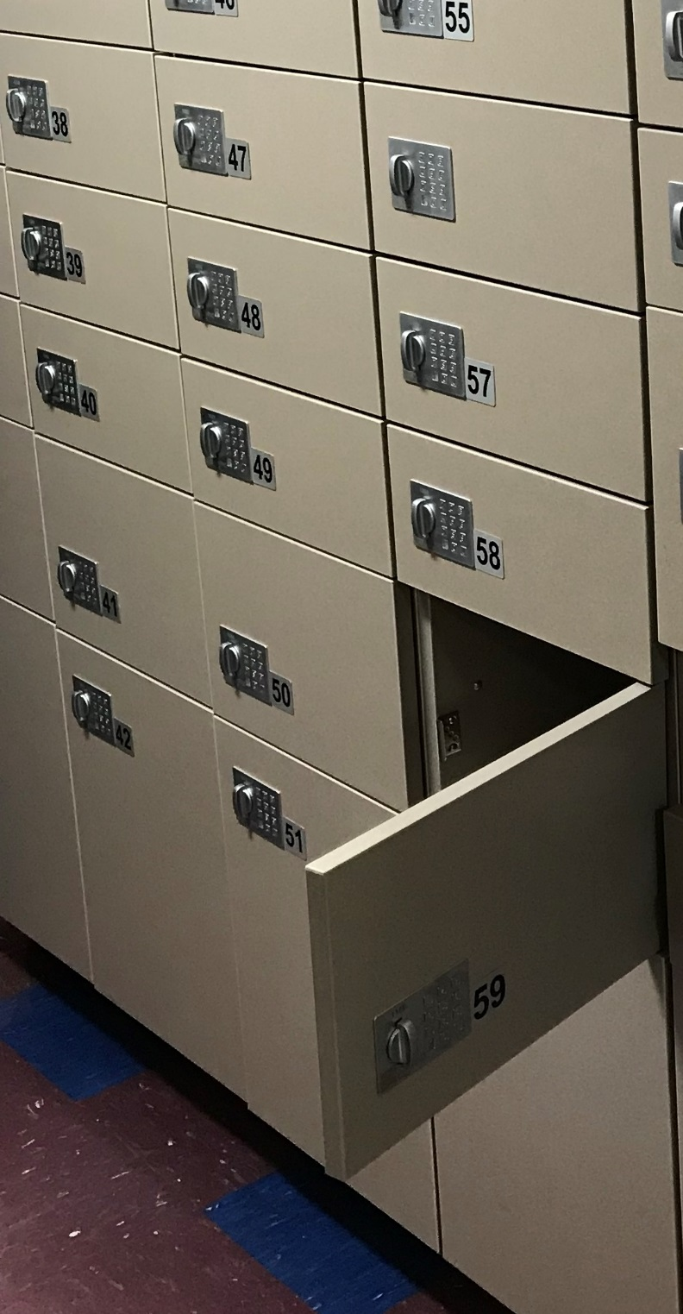
New Technology
Virtual mailrooms
High density mail systems
Parcel lockers

Slide 30
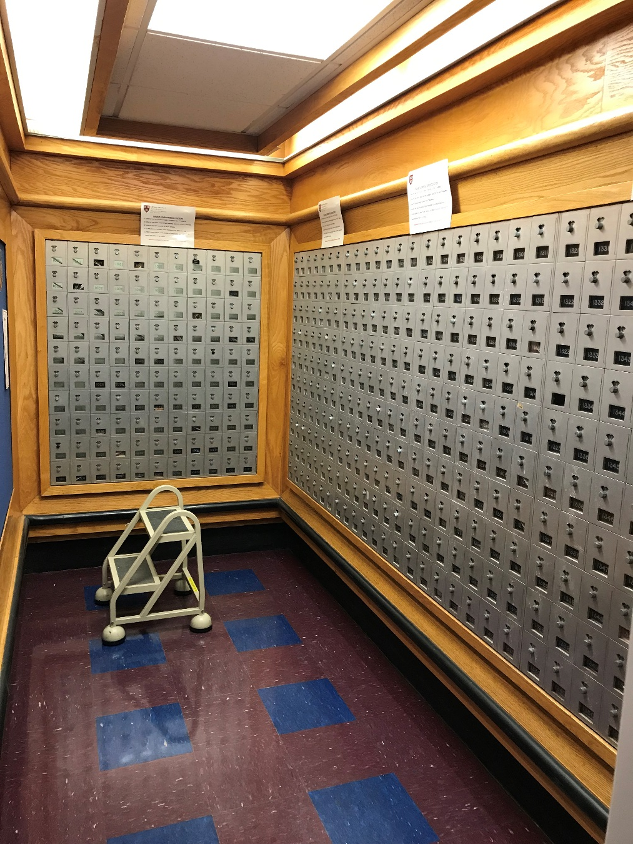
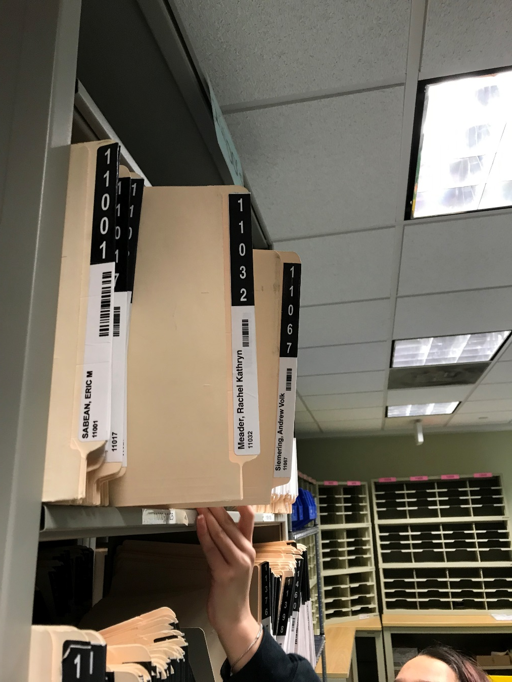

Slide 31
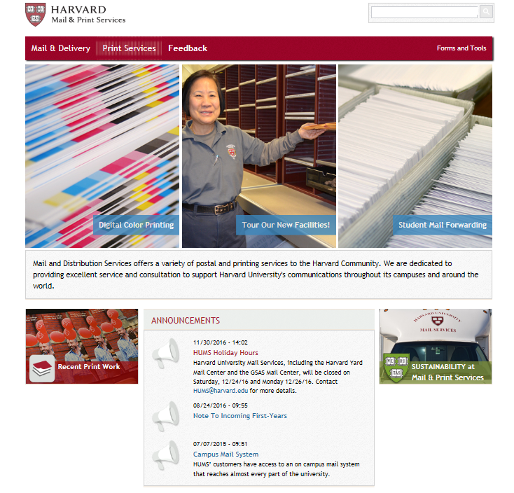
Your Website

Slide 32
What Makes a Good Website?
Update constantly and consistently
Make sure information customers want is easy to find-intuitive
Easy to navigate
Highlight “opportunities”
Use as a marketing tool
Use pictures (of your staff!)
Don’t keep outdated information posted
Google analytics- use them
Don’t use auto-play videos
Make sure links are updated
Make sure updates can be done easily by staff
Don’t overload with text

Slide 33
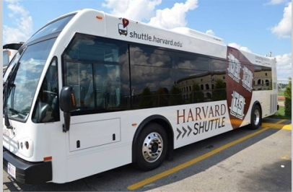
Marketing Ideas
  Giveaways
    They don’t have to be expensive!
    Put your logo/branding out there!
  Word of mouth
    Staff!
  Advertise in areas on Campus
    Student centers
    Transportation
Notes:
Go to slide of business cards next…

Slide 34
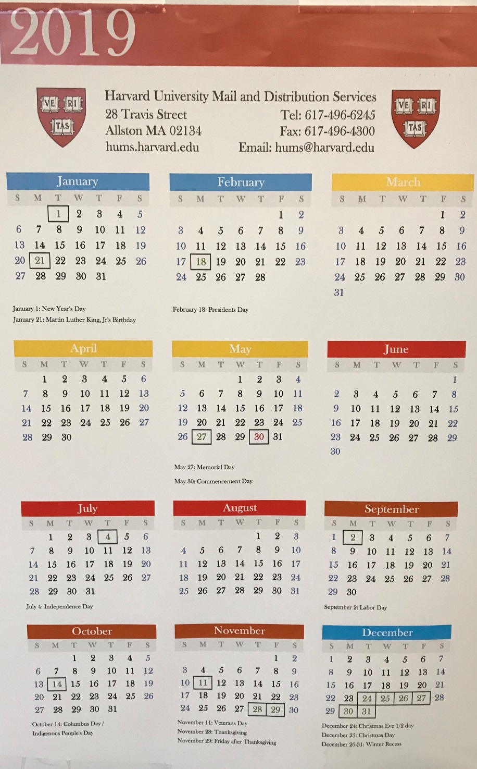
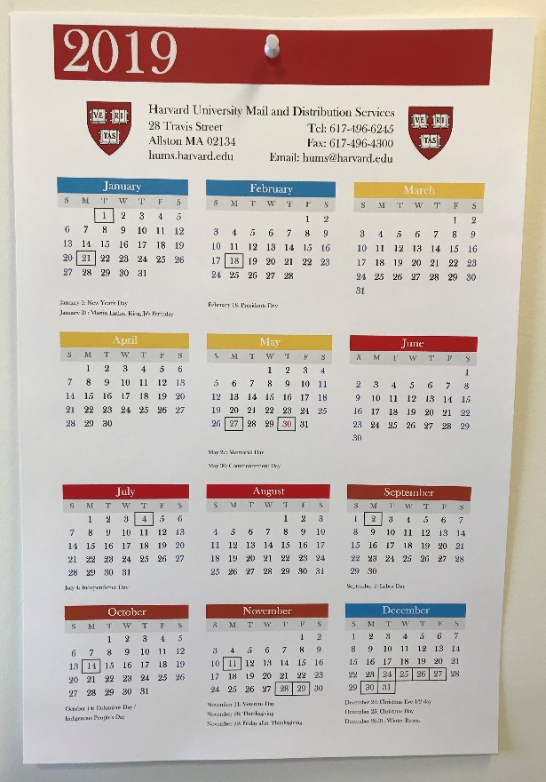

Slide 35
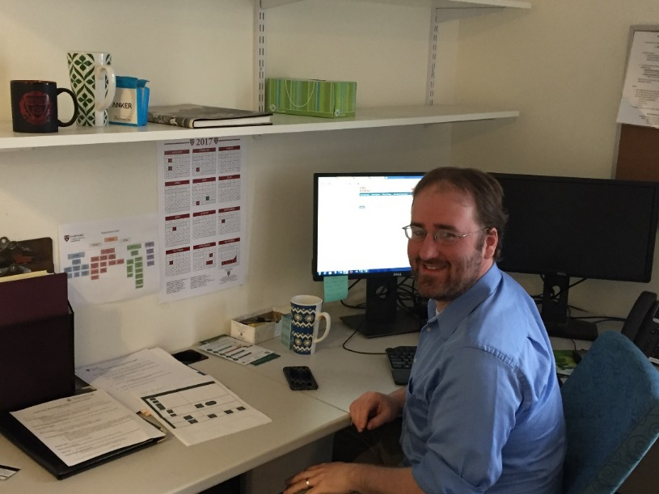
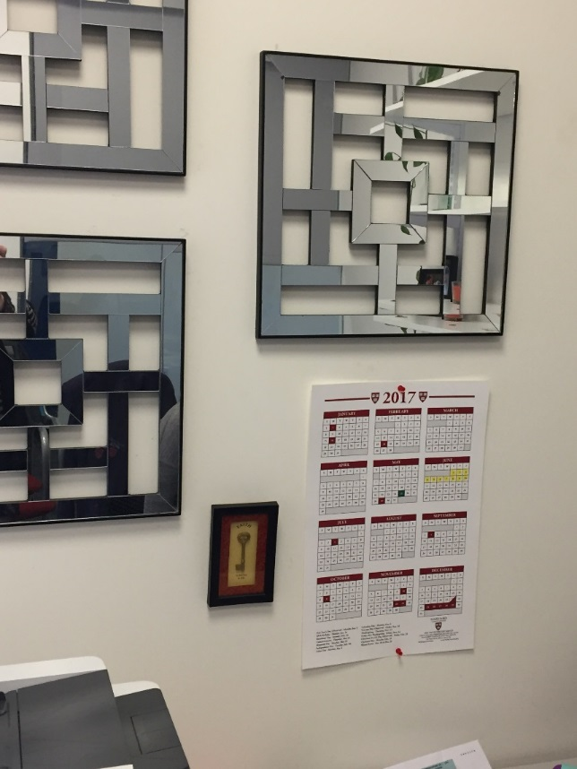
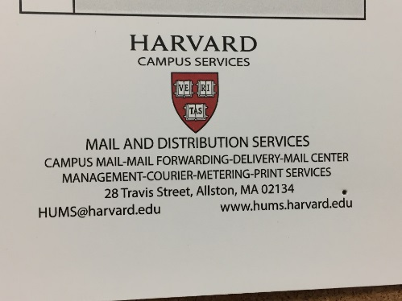

Slide 36
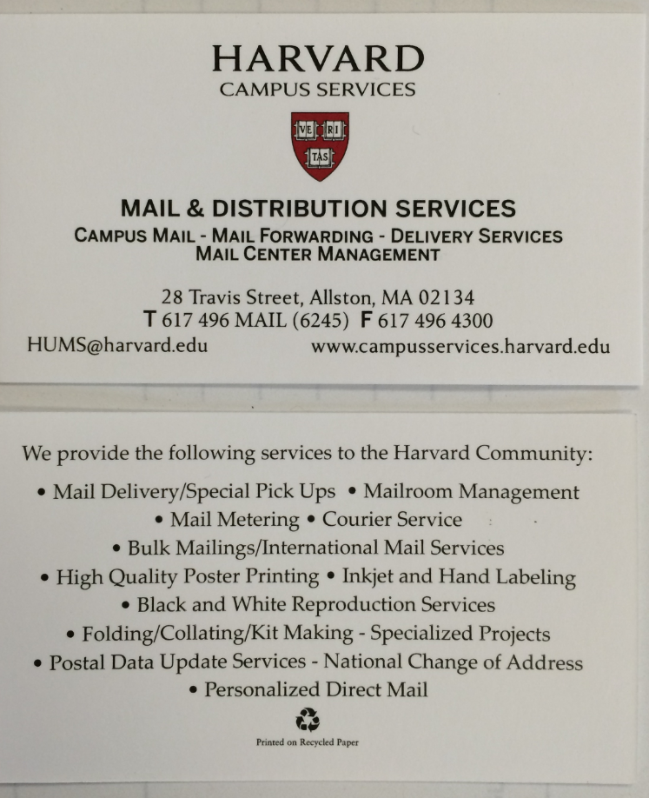

Slide 37

What We did at Harvard:
    Library Courier
    Specialized Courier
    Storage for Events
    Records Management
    Office Moves/equipment moves
    Online Tracking System/on-demand courier
    Mail Count
    Printing

Slide 38

Budget help/physical space allocation
Pick-ups for a fee
Lab couriers
High priority placards
“HIPPA Lady”
Pharmacies
Notary Services
Notes:
Health Information…

Slide 39
Questions?

Slide 40
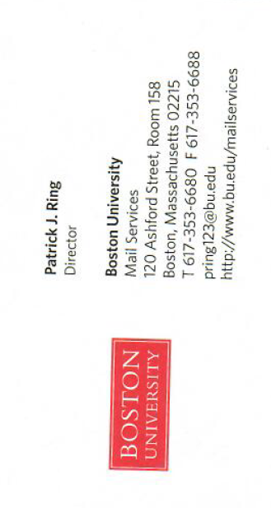

Slide 41
